Slide 1
Real Time Processing With Storm
Mahender Immadi
Software Engineer @ Cerner
www.linkedin.com/in/mahenderimmadi/
Thirupathi Guduru
Software Engineer @ Cerner
www.linkedin.com/in/thirupathireddyguduru/

Slide 2
Batch vs. Real-Time processing
• Batch processing
- Gathering of data and processing as a group at one time.
- Jobs run to completion
- Data might be out of date
• Real-time processing
- Processing of data that takes place as the information is being entered.
- Run for ever

Slide 3
Real Time Use Cases
• Social Media Feeds
• Network Sensors
• App/Web Logs
• Stock Tick Data
• Weather Data
• Auctions
• Payment Transactions

Slide 4
Storm Introduction
• Created by Nathan Marz @ BackType
• Open sourced on 19th September, 2011

Slide 5

Storm
Apache Storm is a free and open source distributed realtime computation system.
Storm makes it easy to reliably process unbounded streams of data, doing for realtime processing what Hadoop did for batch processing

Slide 6
Storm Is
• Stream Processing
• Fast
• Scalable
• Fault Tolerant
• Reliable

Slide 7
Storm Components
• Tuple
• Stream
• Spout
• Bolt
• Topology

Slide 8
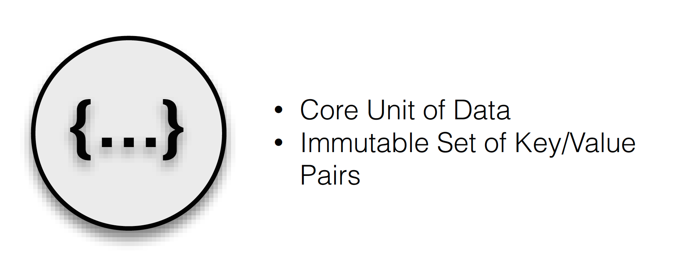
Tuple

Slide 9
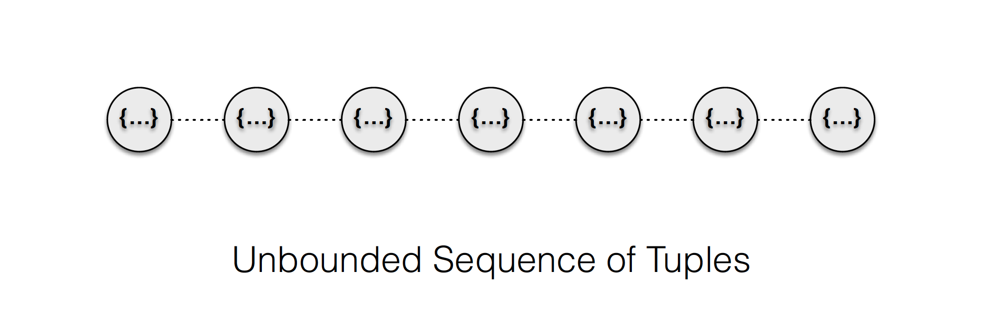
Streams

Slide 10
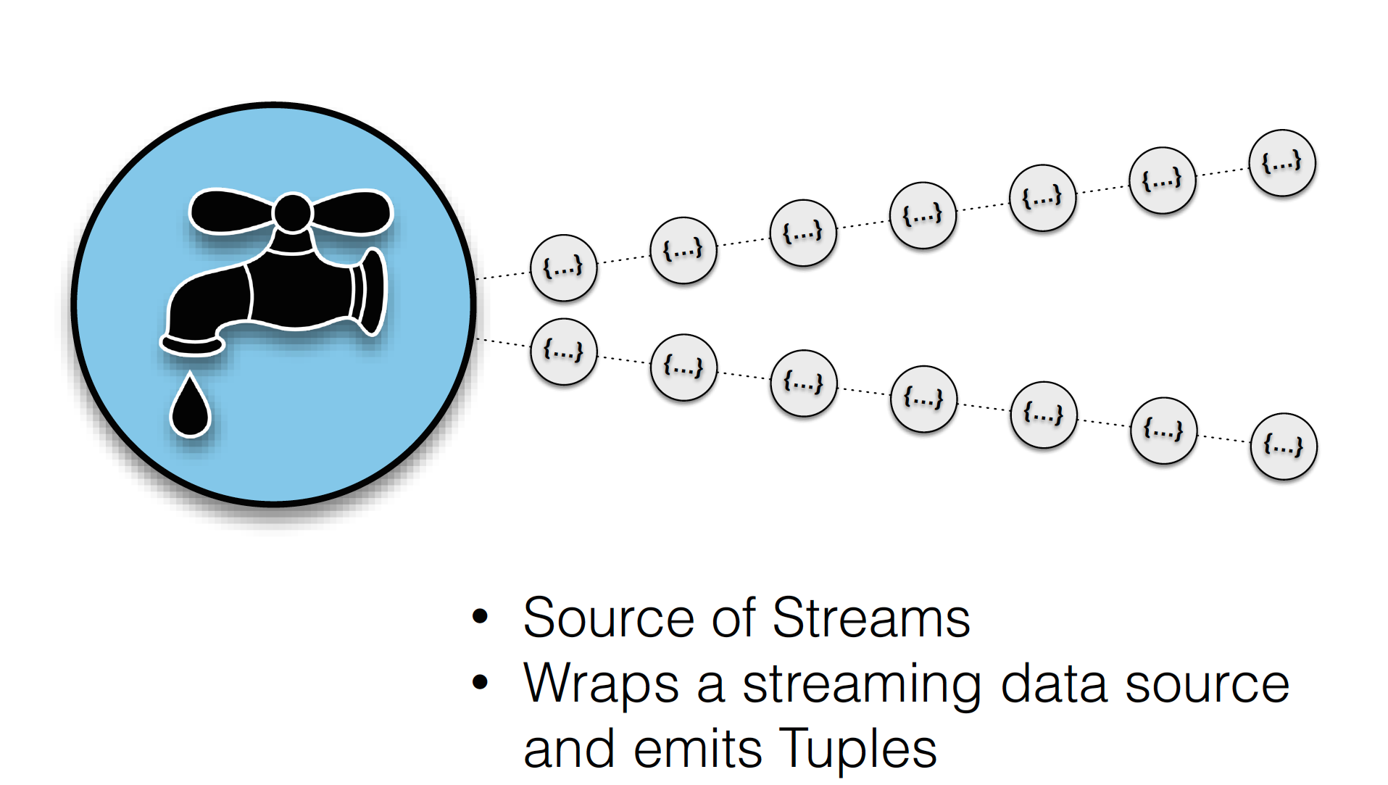
Spouts

Slide 11
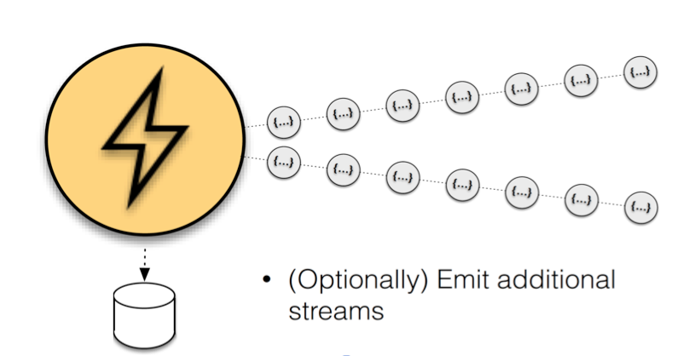
Bolts

Slide 12
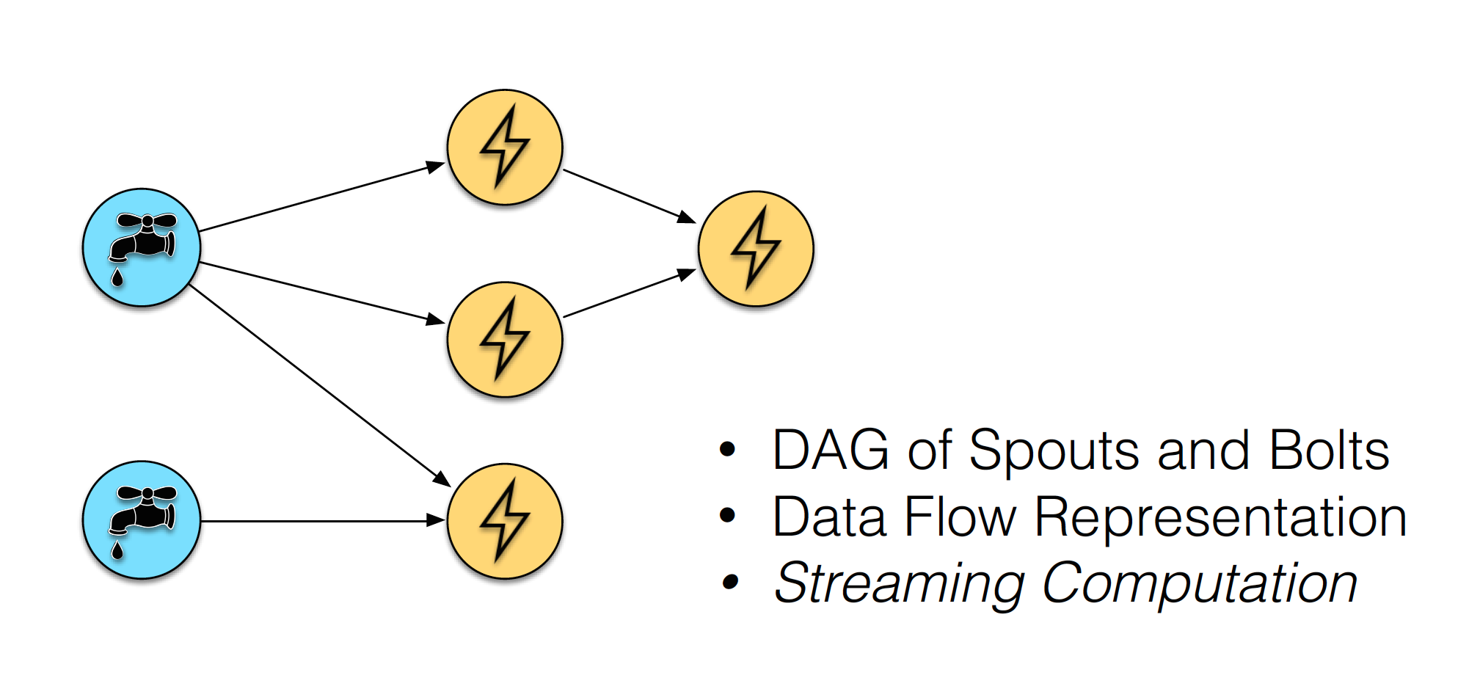
Topologies

Slide 13
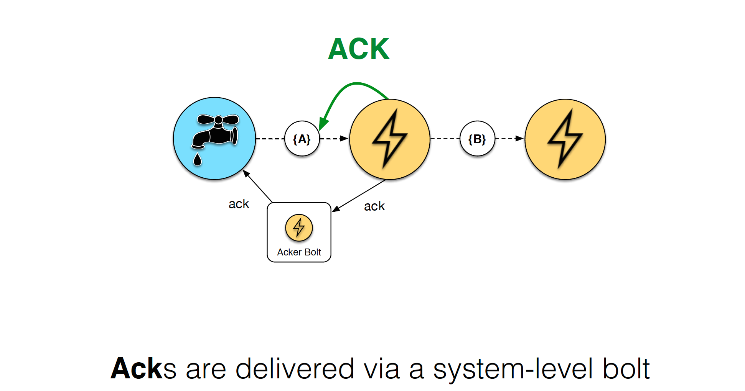
Reliable Processing

Slide 14
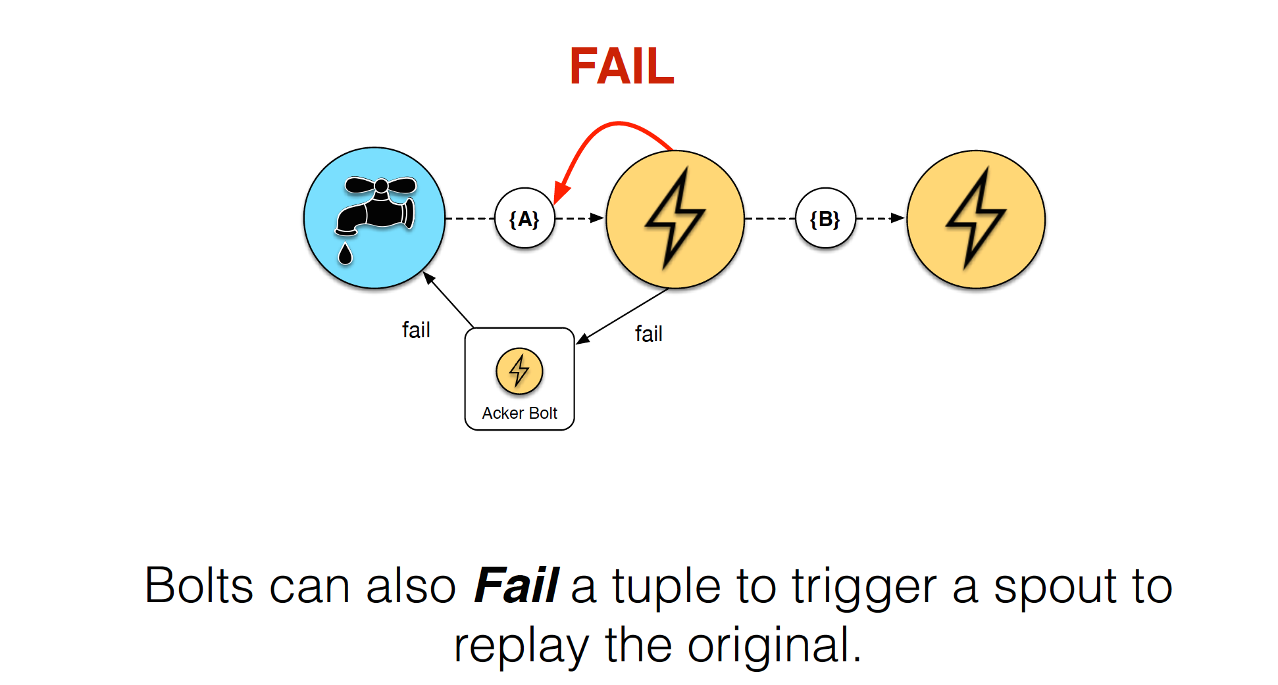
Reliable Processing

Slide 15
Stream Grouping
• Groupings are used to decide to which task in the
subscribing bolt (group) a tuple is sent to.
• Possible Groupings:
- Shuffle
- Fields
- All
- Global
- None
- Direct
- Local or Shuffle

Slide 16
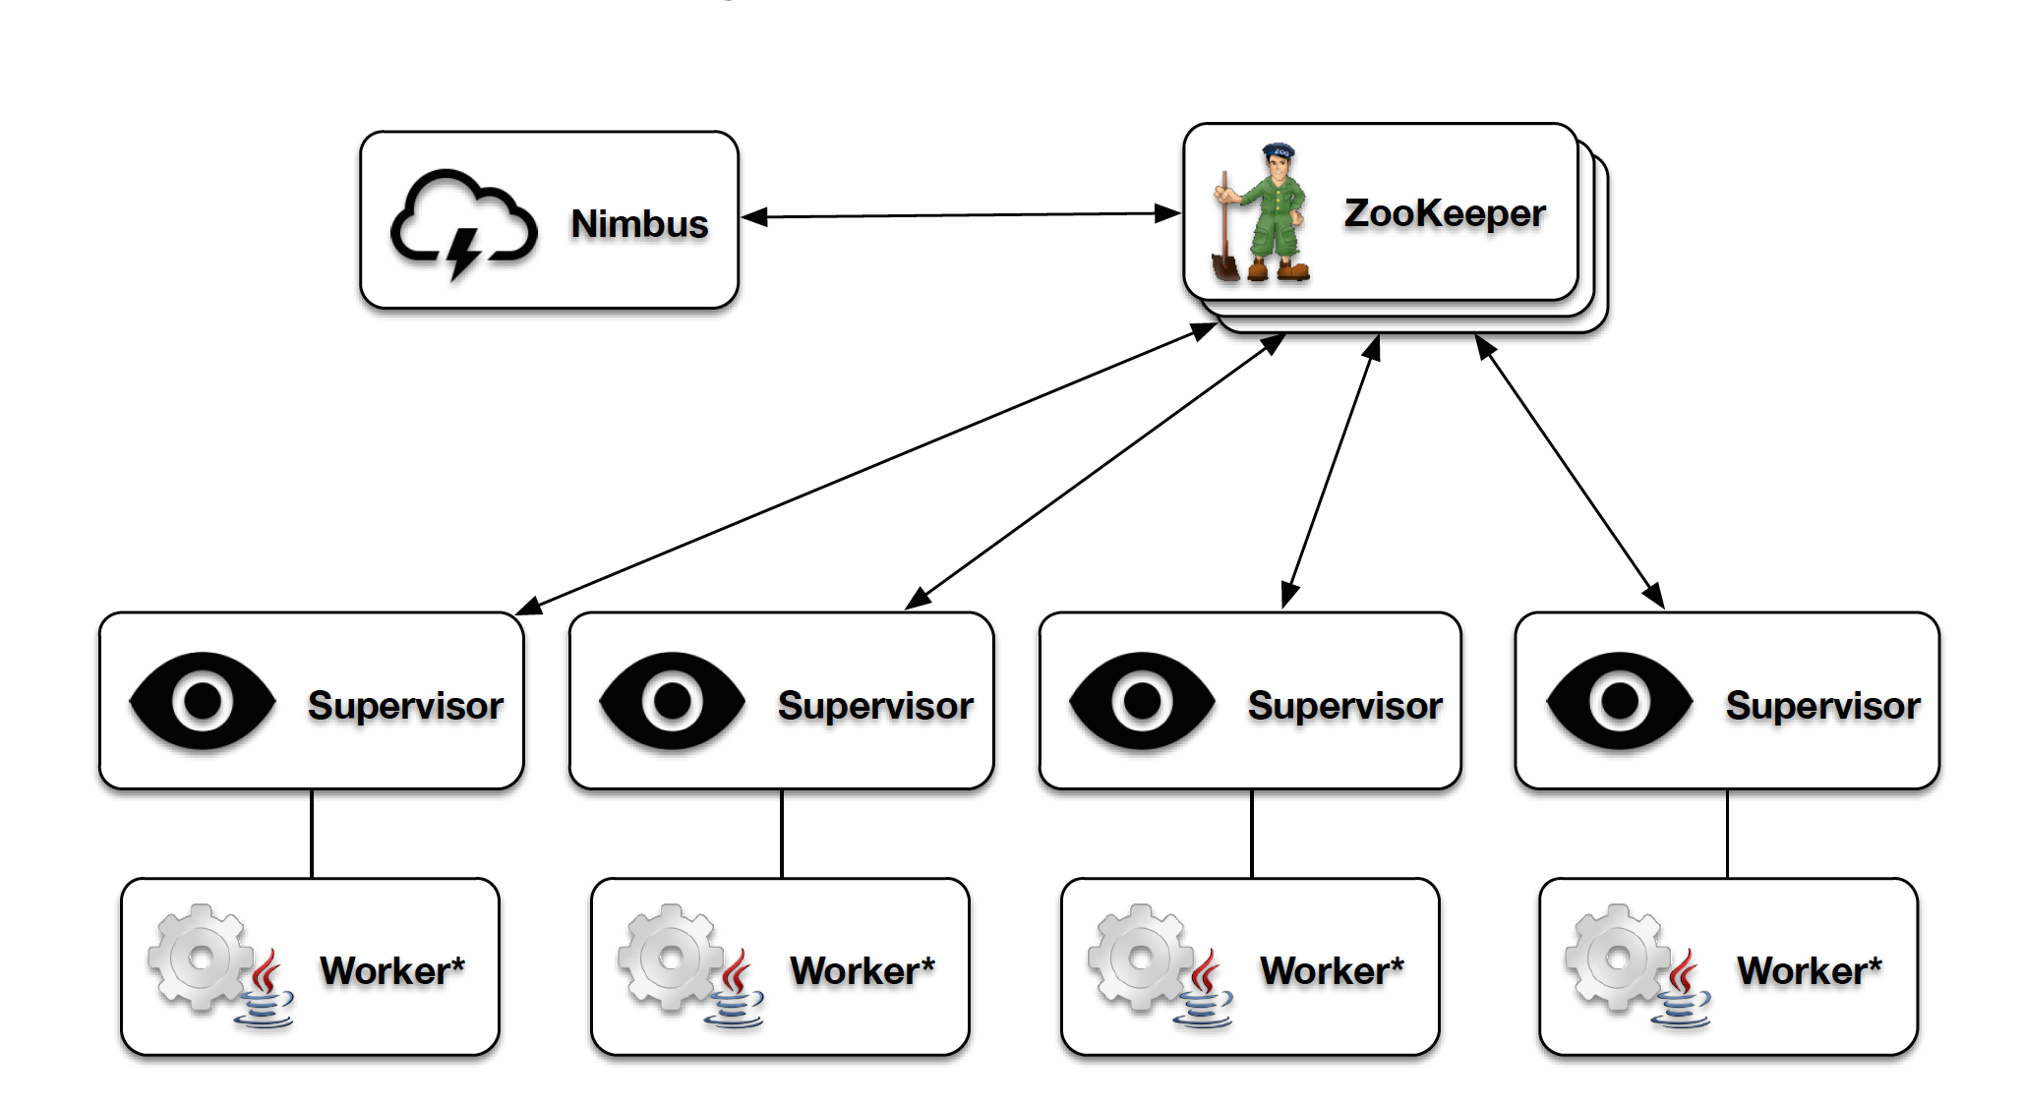
Storm Cluster View

Slide 17
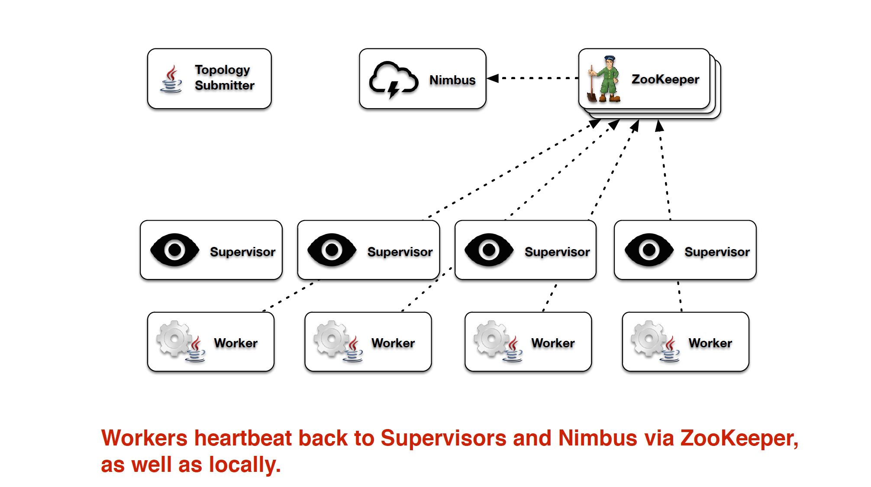
Fault Tolerance

Slide 18
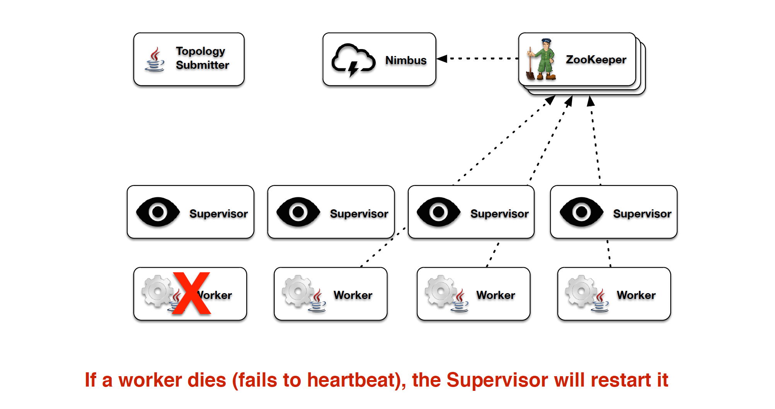
Fault Tolerance

Slide 19
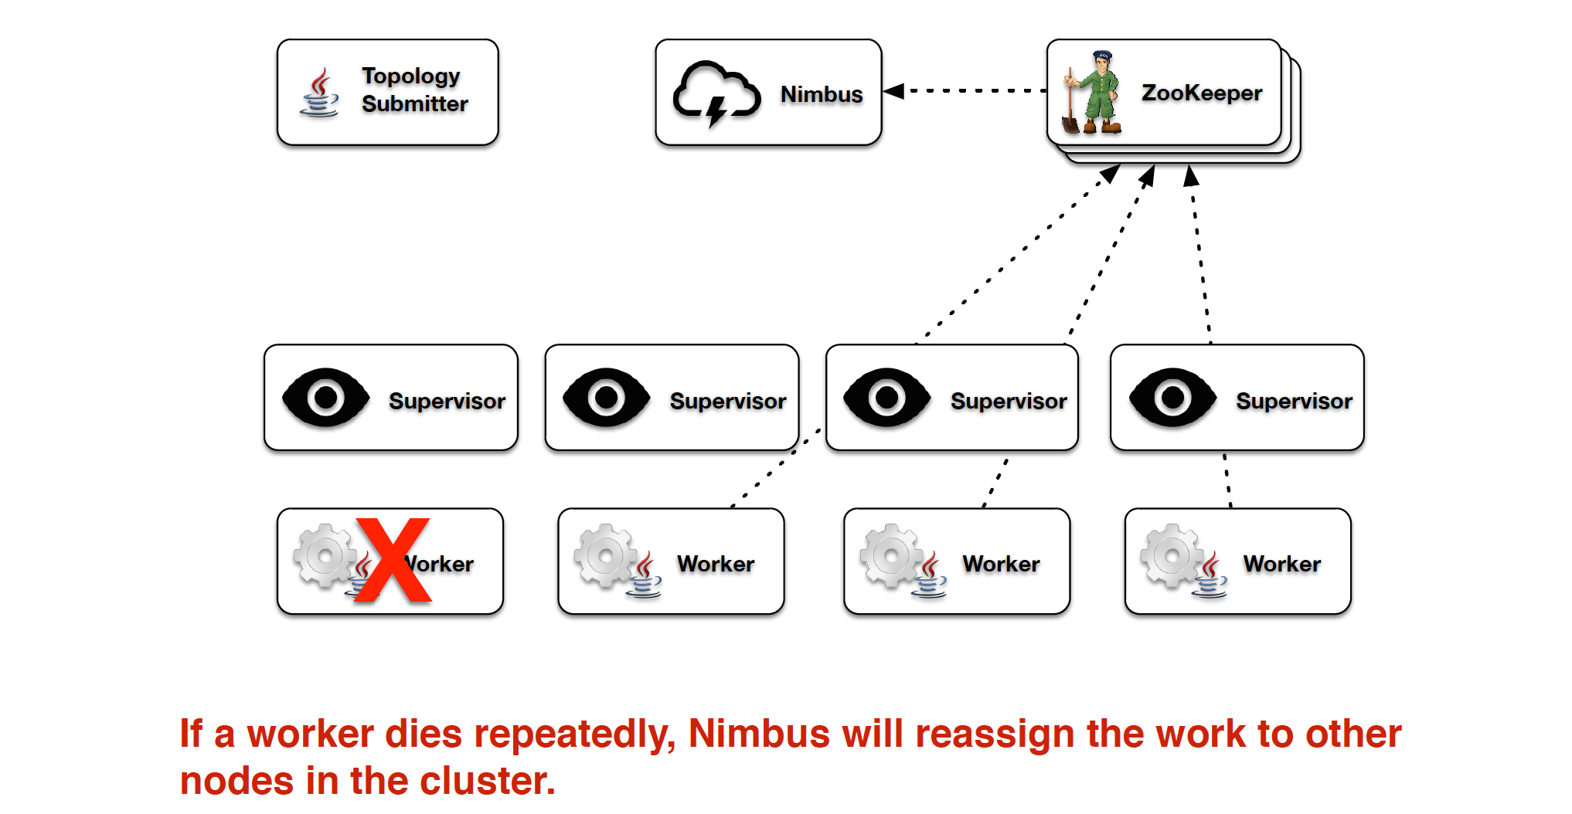
Fault Tolerance

Slide 20
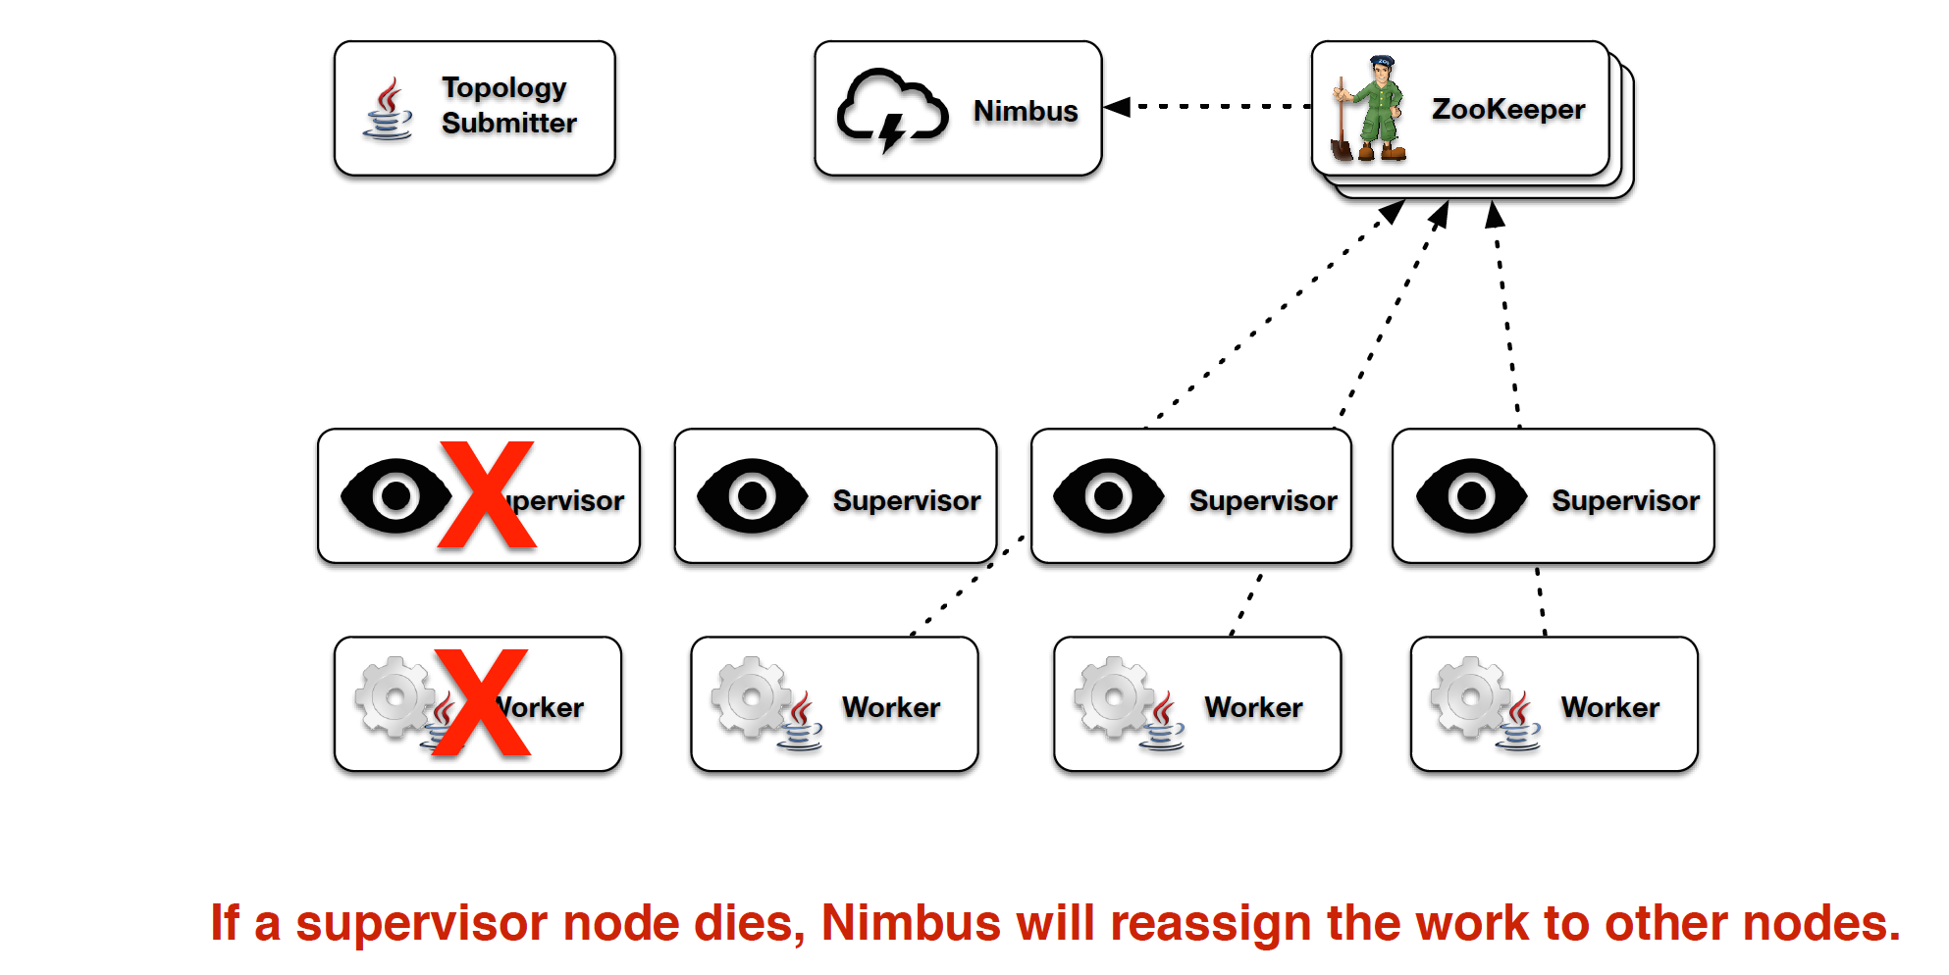
Fault Tolerance

Slide 21
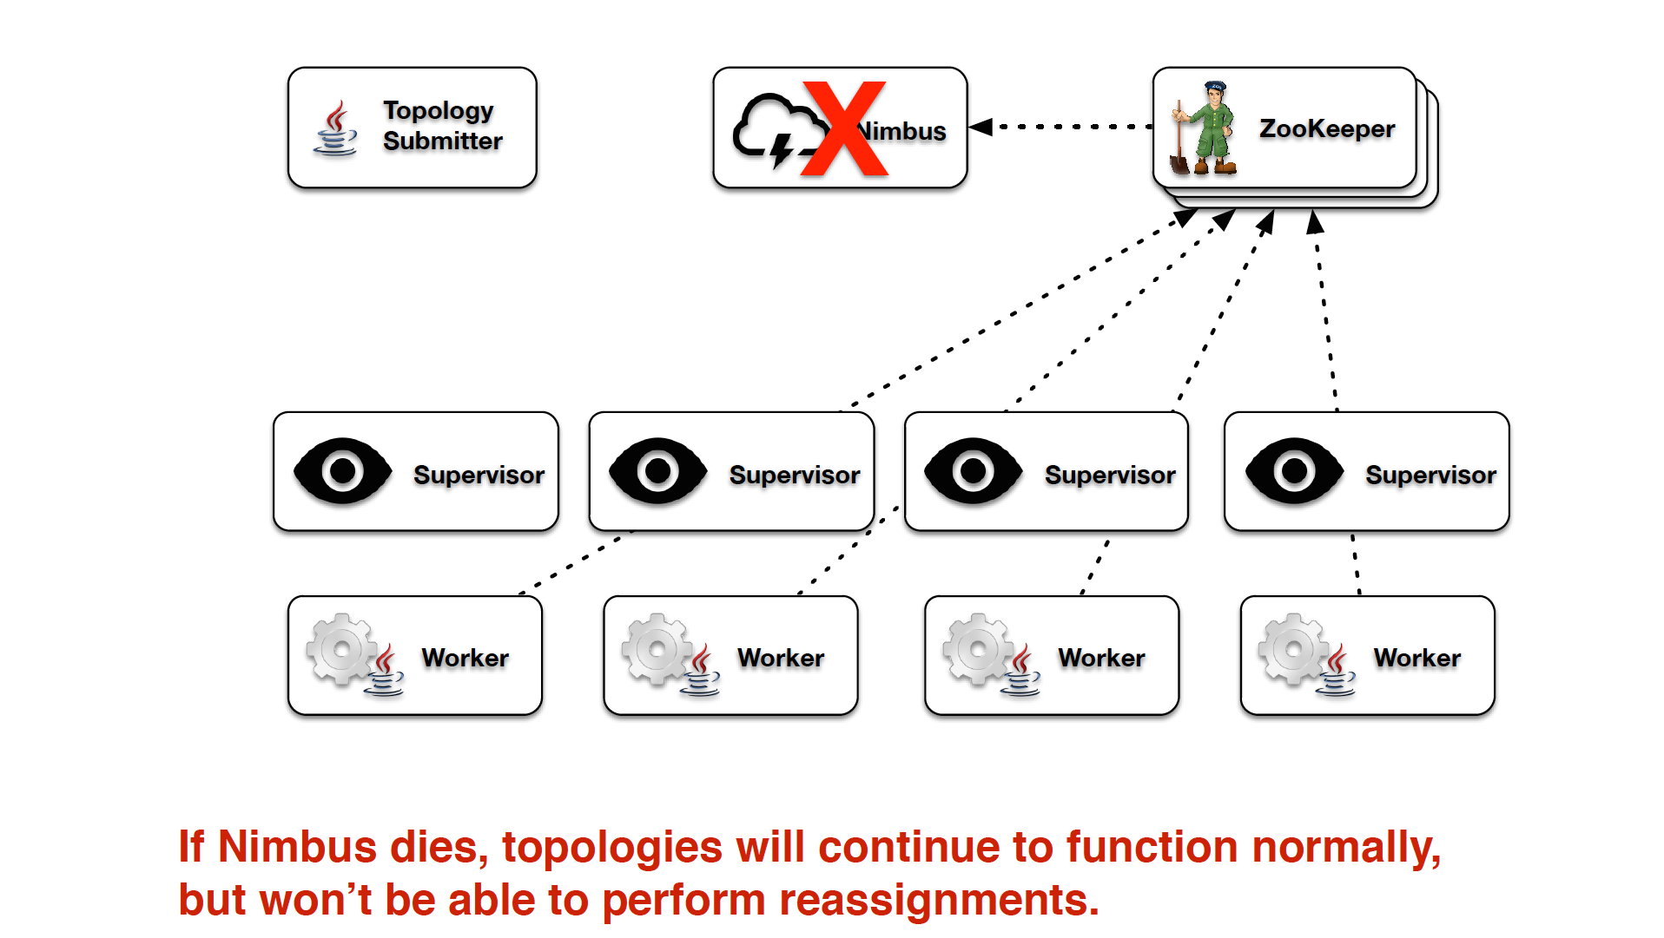
Fault Tolerance

Slide 22
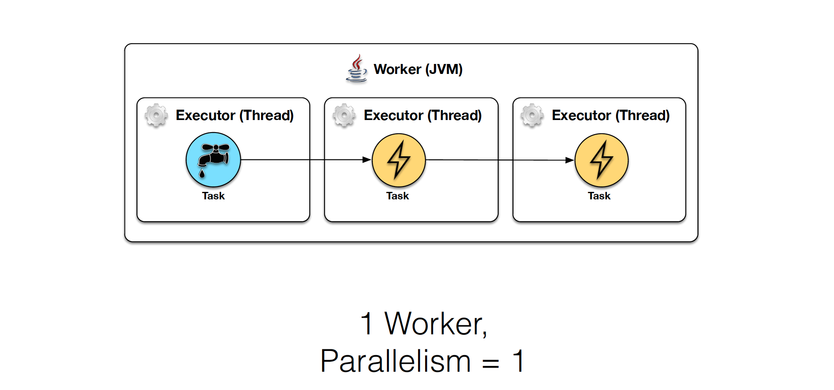
Parallelism

Slide 23
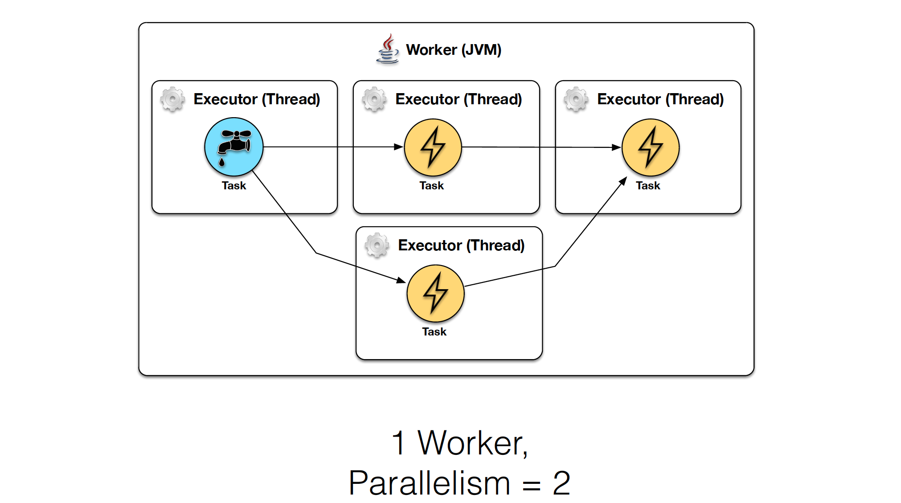
Parallelism

Slide 24
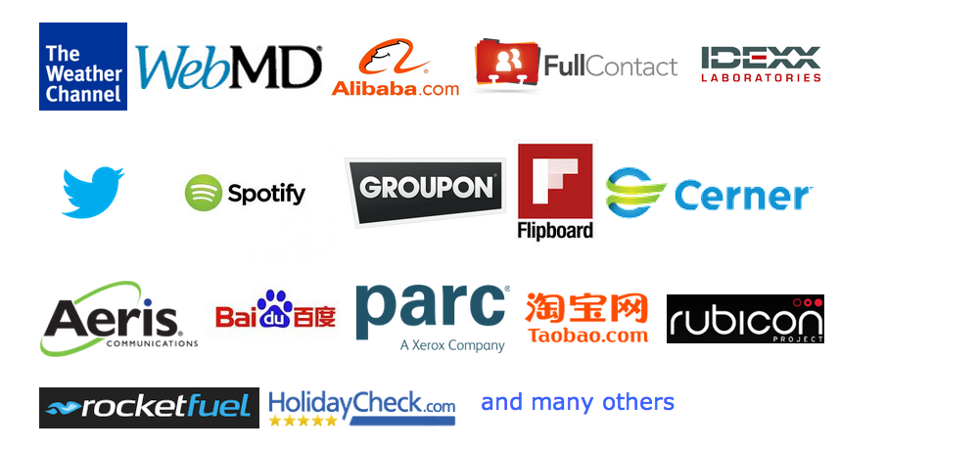
Companies & Projects Using Storm

Slide 25
References
• https://storm.incubator.apache.org/
• http://docs.hortonworks.com/HDPDocuments/HDP2/HDP-2.1.3/bk_user-guide/content/ch_storm-using.html
Books :
• Getting Started with Storm - Jonathan Leibiusky, Gabriel Eisbruch, Dario Simonassi
• Storm Blueprints: Patterns for Distributed Real-time Computation - P. Taylor Goetz, Brian O'Neill

Slide 26
Demo

Slide 27
Q & A

